Slide 1
NRES 776 Final Lab Exam
Available Wednesday, December 8th at 9am, due Tuesday, Dec 14th by 5:00 pm in Collaborate
Open book, independent
Questions based on labs and related theory from lecture
Questions asking what test you would use for data
Interpretation of results (e.g., regression coefficients, AIC table)
Use R to analyze data (see practice questions from labs)

Slide 2
Choosing an analysis
Analysis should follow design
What is your question?
Type of data (nominal, ordinal, discrete, continuous)
Distribution of data (normal, skewed)
Paired or unpaired
Number of groups/comparisons

Slide 3
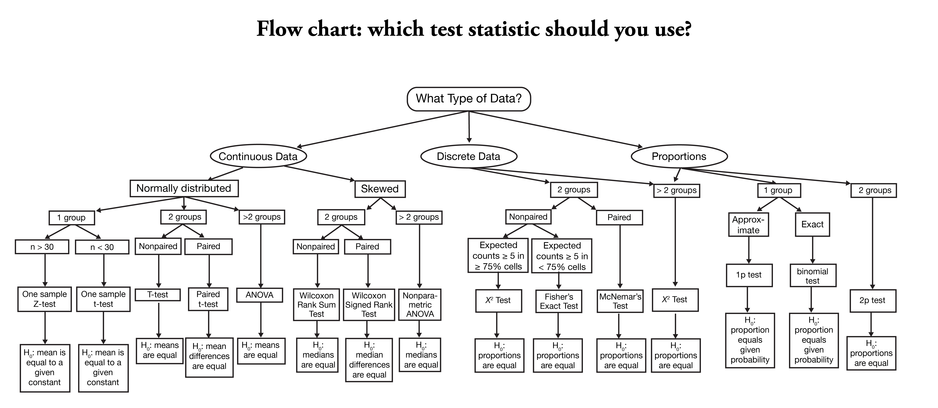
https://onishlab.colostate.edu/wp-content/uploads/2019/07/which_test_flowchart.png

Slide 4
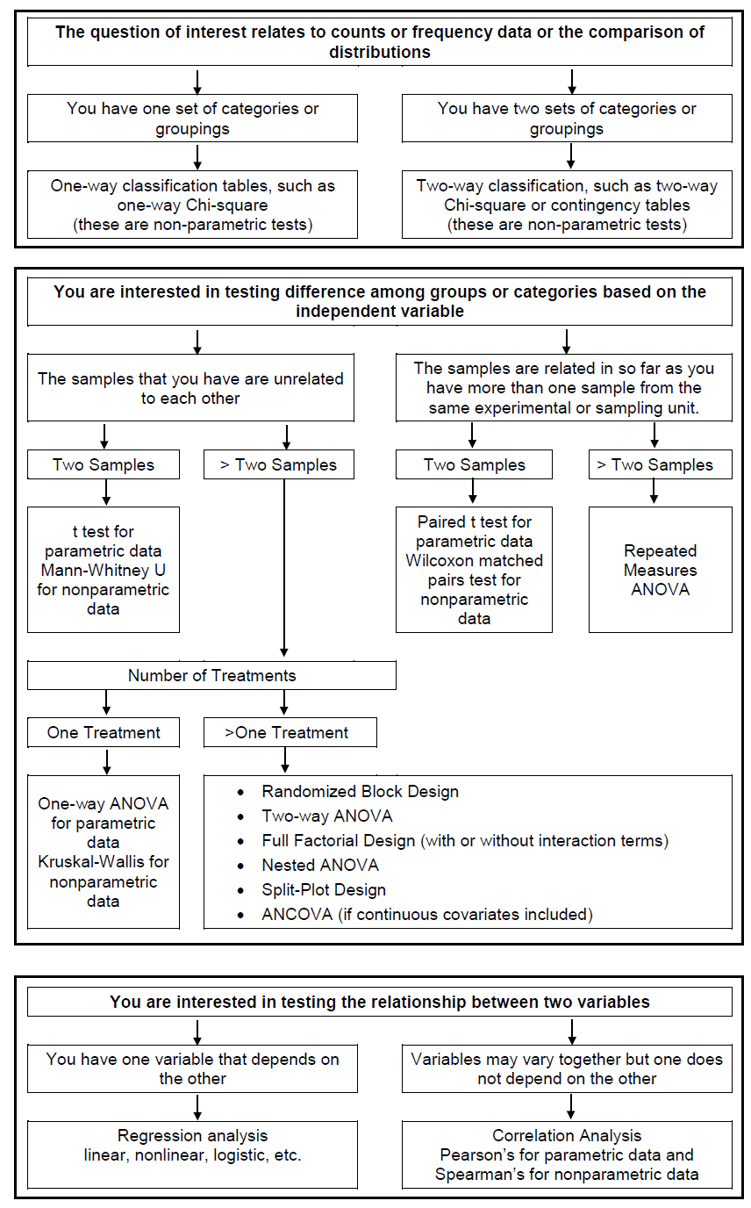
Mike Gillingham

Slide 5
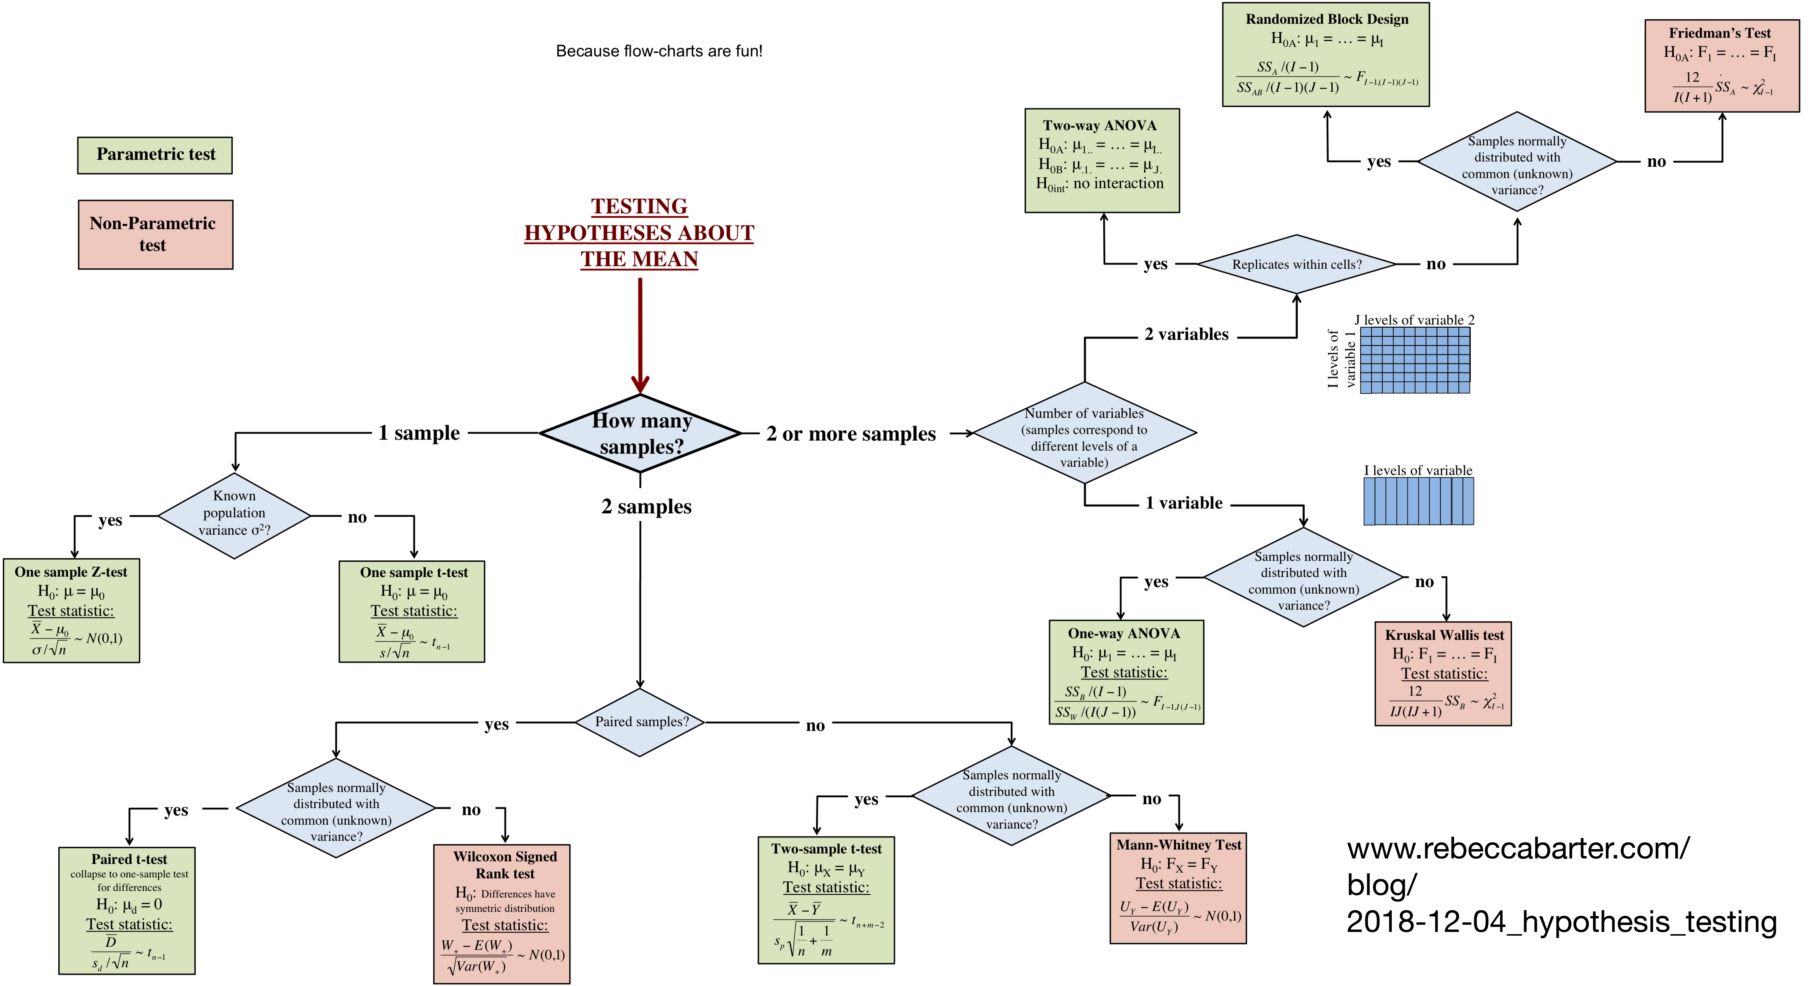

Slide 6
Figure C1: Flow Chart for the Selection of Appropriate Tests
One outcome variable and one predictor variable
One outcome variable; Two or more predictor variables
Outcome: Dichotomous
Predictor: Nominal
Outcome: Categorical
Predictor: Categorical
Outcome: Continuous
Predictor: Nominal
Outcome: Continuous
Predictor: Continuous
ANOVA
Multiple Regression
Logistic Regression
Repeated Measures
Survival Analysis
See Figure C2 for Analysis of Proportions
Outcome: Nominal
Predictor: Nominal
Outcome: Ordinal
Predictor: Ordinal
Outcome: Ordinal
Predictor: Nominal
See Figure C3 for Repeatability, etc.
Regression, Correlation Repeated Measures Time Series
Chi-squared test
Cohen’s kappa
Chi-squared test
Spearman’s rho
(Weighted) kappa
Chi-squared test
Mann-Whitney U
Kruskal-Wallis
Adpated from Statistics for Veterinary and Animal Science by Petrie and Watson

Slide 7
Figure C2: Flow chart for choosing appropriate tests for proportions for an outcome that is dichotomous (binary).
Predictor variable has 2 groups
(Control and Treatment)
Predictor variable has more than 2 groups
(Control and Two or More Treatments)
Independent Groups
Paired
Independent Groups
Assumptions OK
Assumptions not OK
McNemar’s test
or
Sign test
Assumptions OK
Assumptions not OK
Chi-squared test (perhaps for trend)
Chi-squared test
Fisher’s exact test
Combine groups Chi-square test

Slide 8
Figure C3: Flow chart for choosing appropriate tests for an outcome that is continuous.
Predictor variable has 2 groups
(Control and One Treatment)
Predictor variable has more than 2 groups
(Control and Two or More Treatments)
Independent Groups
Paired
Independent Groups
Related Groups
Assumptions OK
Assumptions not OK
Assumptions OK
Assumptions not OK
Assumptions OK
Assumptions not OK
Assumptions OK
Assumptions not OK
Two-sample t-test
Wilcoxon rank sum (or Mann-Whitney) test
Paired t-test
Sign test or Wilcoxon signed rank test
One Way ANOVA
Kruskal-Wallis one-way ANOVA
Friedman two-way ANOVA
ANOVA

Slide 9
What test would you use?
Single continuous response variable and three continuous predictor variables
Single continuous response variable that is non-normally distributed and a categorical predictor variable with two categories
Two continuous variables where you would like to test for an association
Single continuous response variable measured in two treatment groups with three measurements made per individual sampling unit

Slide 10
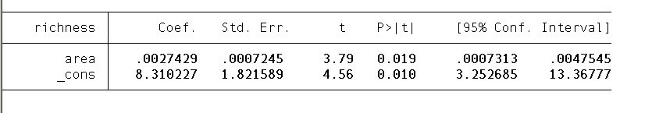
Interpreting Output
Linear regression of island area (in square km) on species richness
What is the statistical hypothesis you are testing?
How would you interpret the effect of area on species richness?
What does the confidence interval mean?

Slide 11
Interpreting Output
Linear regression of island area (in square km) on species richness
What is the statistical hypothesis you are testing?
B1=0 vs. B1≠0
How would you interpret the effect of area on species richness?
Species richness increases by 0.003 for every km-squared increase in island size
What does the confidence interval mean?
If you were to repeat the study many times, 95% of the time, the confidence interval would capture the true value of the regression coefficient for the relationship between island area and species richness. The interval represents a range of plausible values for the coefficient. In this case, plausible values range from 0.007 to 0.005.

Slide 12
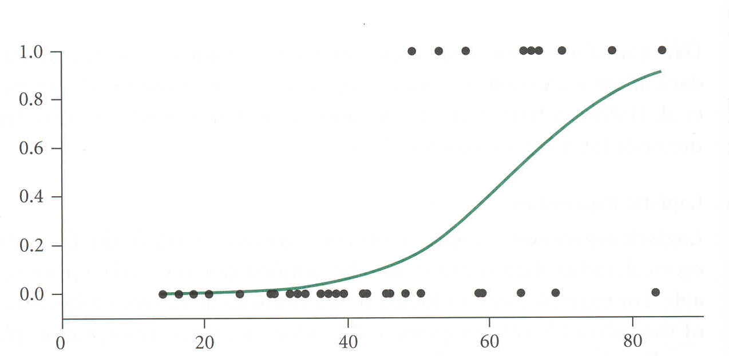
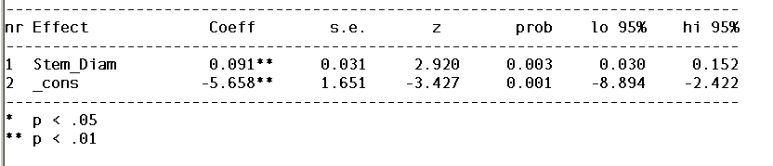
Interpreting Output
Logistic regression using diameter of a twig to predict probability of being browsed by a herbivore (response = browsed versus unbrowsed)
Browsed or unbrowsed
Twig diameter (mm)

Slide 13
Interpreting Output
Logistic regression using diameter of a twig to predict probability of being browsed by a herbivore (response = browsed versus unbrowsed)
Browsed or unbrowsed
Twig diameter (mm)
e^{0.091} = 1.095
Odds of being browsed increase by 1.095 for every millimeter increase in twig diameter
For every millimeter increase in twig diameter, 9.5% more likely to be browsed ...

